Slide 1


Agile Software Development
Topic: Agile Estimation
Dr. Nikhil Govil
Associate Professor, Program Coordinator – B.Tech. (CSE), Dept. of CEA

Slide 2

Agile Estimation
There are three main concepts related to Agile estimation:
Estimation of Size:
It gives a high-level estimate for the work item, typically measured using a neutral unit such as points.
Velocity:
It tells us how many points this project team can deliver with in an iteration / Sprint.
Estimation of Effort:
The estimation of effort indicates how long it will take the team member(s) to complete the assigned work item(s).

Slide 3
Agile Estimation Techniques
Agile estimation is done for proper planning, management and estimating the total efforts required for implementing the requirements.
A poorly estimated project may result as delivering the undesired product and thereby leaving the customer unsatisfied.

Slide 4
Agile Estimation Techniques
There are many techniques for doing estimations in an Agile Project. Some of the popular & widely used techniques are:
Planning Poker
T-Shirt Sizes
Dot Voting
The Bucket System
Ordering Method.

Slide 5
Planning Poker
In this, all the estimators sit in a round circle for the Planning Poker session.
Each estimator is having a set of Planning Poker Cards of values: 0,1/2, 1,2,3,5,8,13,20,40,100 and ?. These values represent story points or measure in which the team estimates.
At the start of the session, the product owner/customer reads out the US, describing all its features and requirements.
After the discussions, all estimators are asked to select one card to estimate the US. If all estimators give same value, then that becomes the final estimate.
If values are different then the estimators giving highest & lowest values explain their opinions & why they chose this value, until a consensus is achieved.

Slide 6
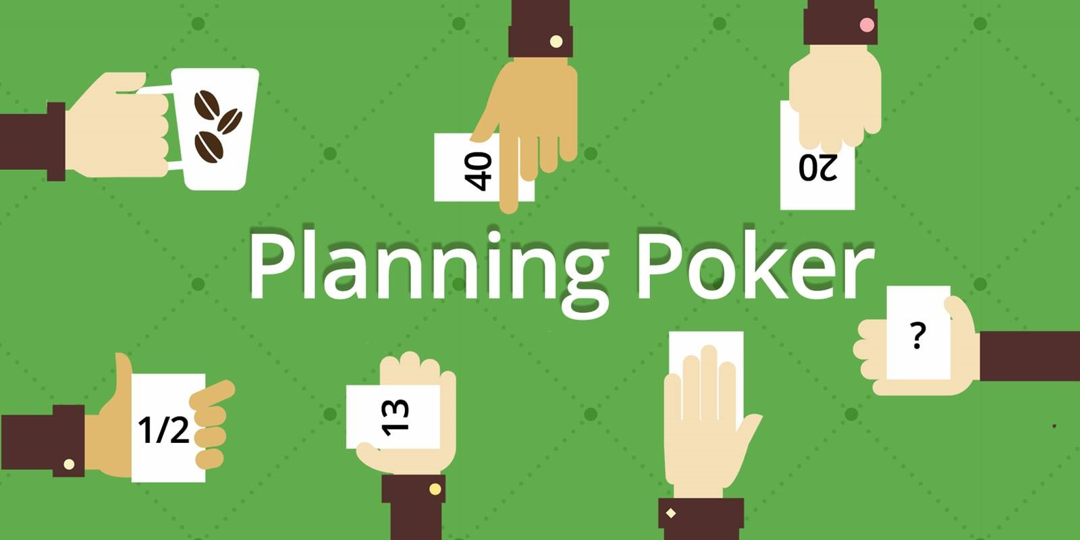
Planning Poker

Slide 7
T – Shirt Sizes
Just as in the case of T-shirts, sizes as: XS (Extra Small), S (Small), M (Medium), L (Large), XL (Extra Large). A similar approach is followed here. Items are estimated in T-shirt sizes.
This is a perfect technique to give a rough estimation of the large backlog of items.
Useful when quick & rough estimation needs to be done. Later these sizes can be converted into numbers as per the requirement.
A relative size (mostly Medium) is decided after mutual discussion & agreement of the team members or estimators. Then, the numbers are assigned to the items according to the relative size that is assigned to Medium size.

Slide 8
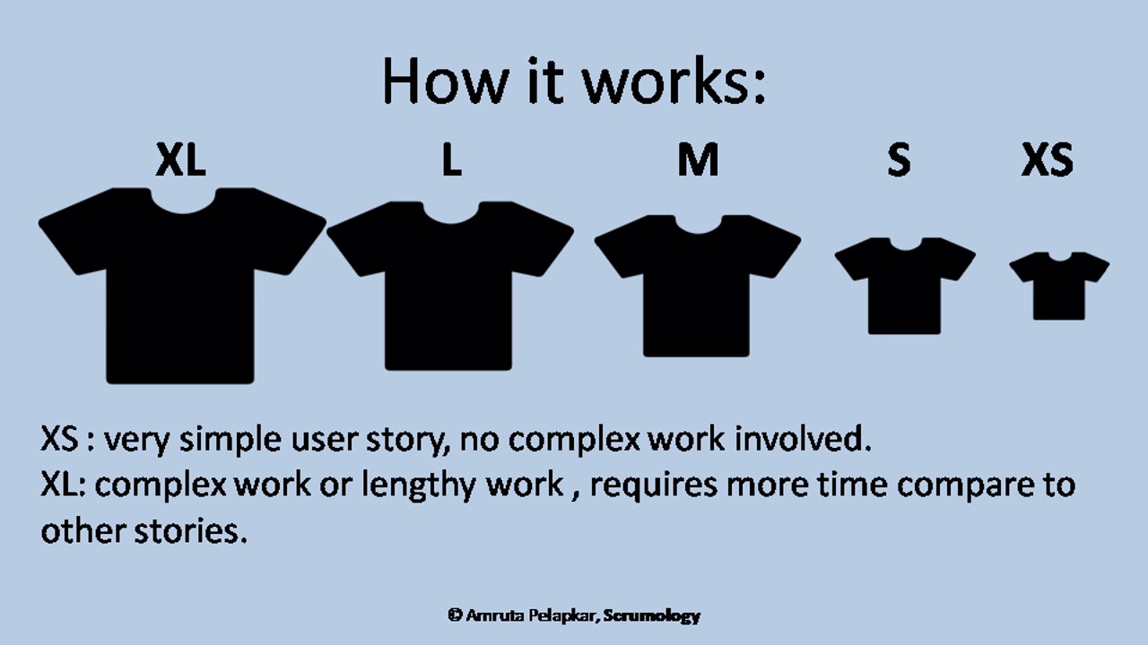
T – Shirt Sizes

Slide 9
Dot Voting
This is basically a ranking method to decide the order of the Product Backlog from the highest priority stories to lowest priority stories.
To start with this, post all the user stories along with their description on the wall or board using yellow stickies.
All stakeholders are given 4 to 5 dots (mostly in the form of stickers, pens or markers can also be used to make dot).
Product Owner orders the product backlog items from the most preferred (one with most no. of dots) to the least preferred (one with least no. of dots).

Slide 10
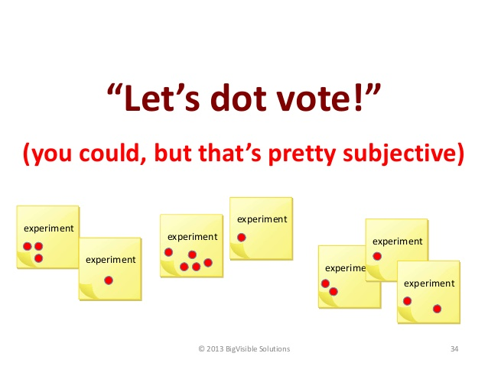
Dot Voting

Slide 11
The Bucket System
It is a good technique when a large no. of items are to be estimated by large no. of participants.
Different buckets are created with values: 0,1,2,3,4,5,8,13,20,30,50,100, 200.
These buckets are nothing but cards representing values arranged sequentially on a table.
The stories need to be placed within these where the estimator finds them suitable.
Pick an story at random, discuss all its features and requirements with the group and place it in the appropriate bucket.

Slide 12
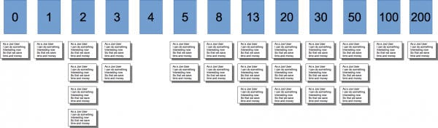
The Bucket System

Slide 13
Ordering Method
A good technique when large no. of items and small no. of people are there.
It gives accurate relative sizes for the product backlog items.
A scale is prepared ranging from low to high. All the items are placed randomly on it. Each participant is asked to move any one item on the scale, at one time.
This continues until all the participants are satisfied and don’t want to move any item on the scale.
This also gives the priority order of the Product Backlog items.

Slide 14
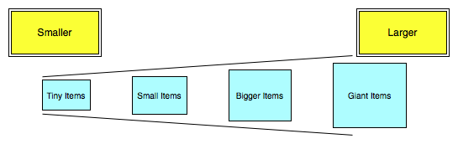
Ordering Method

Slide 15
User Story 1
As a user, I want to log in using my email and password so that I can access my account.
Acceptance Criteria:
User can enter email and password.
User receives feedback for incorrect login details.
User is redirected to the dashboard after successful login.

Slide 16
User Story 2
As a user, I want to reset my password so that I can regain access to my account if I forget it.
Acceptance Criteria:
User can request a password reset link.
User receives an email with the reset link.
User can set a new password.

Slide 17
User Story 3
As a user, I want to view my profile details so that I can check my personal information.
Acceptance Criteria:
User can access the profile page.
User can see name, email, and other personal details.

Slide 18
User Story 4
As a user, I want to edit my profile information so that I can keep my details up to date.
Acceptance Criteria:
User can edit fields like name, phone number, address, etc.
Changes are saved and reflected on the profile page.
User receives confirmation of successful update.

Slide 19
User Story 5
As a user, I want to search for items on the website so that I can find specific products quickly.
Acceptance Criteria:
User can enter keywords in a search bar.
Results display items matching the keywords.
User can click on an item to view details.

Slide 20
References
Ken Schawber & Mike Beedle, Agile Software Development with Scrum, Pearson, 2008.
Robert C. Martin, Agile Software Development, Principles, Patterns and Practices, Prentice Hall,2002.
Lisa Crispin & Janet Gregory, Agile Testing: A Practical Guide for Testers and Agile Teams, Addison Wesley, 2008.
Alistair Cockburn, Agile Software Development: The Cooperative Game, Addison Wesley, 2006.
https://www.softwaretestinghelp.com/agile-estimation-techniques/last accessed on 25/8/2024.

Slide 21


